Slide 1
Virtual Memory
Oct. 29, 2002
15-213
“The course that gives CMU its Zip!”
Topics
  Motivations for VM
  Address translation
  Accelerating translation with TLBs
class19.ppt

Slide 2
Motivations for Virtual Memory
Use Physical DRAM as a Cache for the Disk
  Address space of a process can exceed physical memory size
  Sum of address spaces of multiple processes can exceed physical memory
Simplify Memory Management
  Multiple processes resident in main memory.
    Each process with its own address space
  Only “active” code and data is actually in memory
    Allocate more memory to process as needed.
Provide Protection
  One process can’t interfere with another.
    because they operate in different address spaces.
  User process cannot access privileged information
    different sections of address spaces have different permissions.

Slide 3
Motivation #1: DRAM a “Cache” for Disk
Full address space is quite large:
  32-bit addresses: ~4,000,000,000 (4 billion) bytes
  64-bit addresses: ~16,000,000,000,000,000,000 (16 quintillion) bytes
Disk storage is ~300X cheaper than DRAM storage
  80 GB of DRAM: ~ $33,000
  80 GB of disk: ~ $110
To access large amounts of data in a cost-effective manner, the bulk of the data must be stored on disk
80 GB: ~$110
1GB: ~$200
4 MB: ~$500
SRAM
DRAM
Disk

Slide 4
Levels in Memory Hierarchy
cache
virtual memory
CPU
C
a
c
h
e
Memory
8 B
32 B
4 KB
disk
regs
Register
Cache
Memory
Disk Memory
size:
speed:
$/Mbyte:
line size:
32 B
1 ns
8 B
32 KB-4MB
2 ns
$125/MB
32 B
1024 MB
30 ns
$0.20/MB
4 KB
100 GB
8 ms
$0.001/MB
larger, slower, cheaper

Slide 5
DRAM vs. SRAM as a “Cache”
DRAM vs. disk is more extreme than SRAM vs. DRAM
  Access latencies:
    DRAM ~10X slower than SRAM
    Disk ~100,000X slower than DRAM
  Importance of exploiting spatial locality:
    First byte is ~100,000X slower than successive bytes on disk
      vs. ~4X improvement for page-mode vs. regular accesses to DRAM
  Bottom line:
    Design decisions made for DRAM caches driven by enormous cost of misses
SRAM
DRAM
Disk

Slide 6
Impact of Properties on Design
If DRAM was to be organized similar to an SRAM cache, how would we set the following design parameters?
  Line size?
    Large, since disk better at transferring large blocks
  Associativity?
    High, to mimimize miss rate
  Write through or write back?
    Write back, since can’t afford to perform small writes to disk
What would the impact of these choices be on:
  miss rate
    Extremely low. << 1%
  hit time
    Must match cache/DRAM performance
  miss latency
    Very high. ~20ms
  tag storage overhead
    Low, relative to block size

Slide 7
Locating an Object in a “Cache”
SRAM Cache
  Tag stored with cache line
  Maps from cache block to memory blocks
    From cached to uncached form
    Save a few bits by only storing tag
  No tag for block not in cache
  Hardware retrieves information
    can quickly match against multiple tags
“Cache”
Tag
Data
Object Name
0:
D
243
X
= X?
1:
X
17
•
•
•
•
•
•
N-1:
J
105

Slide 8
Locating an Object in “Cache” (cont.)
DRAM Cache
  Each allocated page of virtual memory has entry in page table
  Mapping from virtual pages to physical pages
    From uncached form to cached form
  Page table entry even if page not in memory
    Specifies disk address
    Only way to indicate where to find page
  OS retrieves information
Page Table
“Cache”
Location
Data
Object Name
D:
0
0:
243
X
J:
On Disk
1:
17
•
•
•
•
•
•
X:
1
N-1:
105

Slide 9
A System with Physical Memory Only
Examples:
  most Cray machines, early PCs, nearly all embedded systems, etc.
Memory
0:
Physical
Addresses
1:
CPU
N-1:
Addresses generated by the CPU correspond directly to bytes in physical memory

Slide 10
A System with Virtual Memory
Examples:
  workstations, servers, modern PCs, etc.
Memory
0:
Page Table
1:
Virtual
Addresses
Physical
Addresses
0:
1:
CPU
P-1:
N-1:
Disk
Address Translation: Hardware converts virtual addresses to physical addresses via OS-managed lookup table (page table)

Slide 11
Page Faults (like “Cache Misses”)
What if an object is on disk rather than in memory?
  Page table entry indicates virtual address not in memory
  OS exception handler invoked to move data from disk into memory
    current process suspends, others can resume
    OS has full control over placement, etc.
Before fault
After fault
Memory
Memory
Page Table
Virtual
Addresses
Physical
Addresses
Page Table
Virtual
Addresses
Physical
Addresses
CPU
CPU
Disk
Disk

Slide 12
Servicing a Page Fault
(1) Initiate Block Read
Processor Signals Controller
  Read block of length P starting at disk address X and store starting at memory address Y
Read Occurs
  Direct Memory Access (DMA)
  Under control of I/O controller
I / O Controller Signals Completion
  Interrupt processor
  OS resumes suspended process
Processor
Reg
(3) Read Done
Cache
Memory-I/O bus
(2) DMA Transfer
I/O
controller
Memory
disk
disk
Disk
Disk

Slide 13
Motivation #2: Memory Management
Multiple processes can reside in physical memory.
How do we resolve address conflicts?
  what if two processes access something at the same address?
kernel virtual memory
memory invisible to
user code
%esp
stack
Linux/x86 process
memory
image
Memory mapped region
forshared libraries
runtime heap (via malloc)
the “brk” ptr
uninitialized data (.bss)
initialized data (.data)
program text (.text)
forbidden
0

Slide 14
Solution: Separate Virt. Addr. Spaces
  Virtual and physical address spaces divided into equal-sized blocks
    blocks are called “pages” (both virtual and physical)
  Each process has its own virtual address space
    operating system controls how virtual pages as assigned to physical memory
0
Physical
Address
Space (DRAM)
Virtual Address Space for Process 1:
0
Address Translation
VP 1
PP 2
VP 2
...
N-1
(e.g., read/only library code)
PP 7
Virtual Address Space for Process 2:
0
VP 1
VP 2
PP 10
...
M-1
N-1

Slide 15
Contrast: Macintosh Memory Model
MAC OS 1–9
  Does not use traditional virtual memory
All program objects accessed through “handles”
  Indirect reference through pointer table
  Objects stored in shared global address space
Shared Address Space
P1 Pointer Table
A
Process P1
B
“Handles”
P2 Pointer Table
C
Process P2
D
E

Slide 16
Macintosh Memory Management
Allocation / Deallocation
  Similar to free-list management of malloc/free
Compaction
  Can move any object and just update the (unique) pointer in pointer table
Shared Address Space
P1 Pointer Table
B
Process P1
A
“Handles”
P2 Pointer Table
C
Process P2
D
E

Slide 17
Mac vs. VM-Based Memory Mgmt
Allocating, deallocating, and moving memory:
  can be accomplished by both techniques
Block sizes:
  Mac: variable-sized
    may be very small or very large
  VM: fixed-size
    size is equal to one page (4KB on x86 Linux systems)
Allocating contiguous chunks of memory:
  Mac: contiguous allocation is required
  VM: can map contiguous range of virtual addresses to disjoint ranges of physical addresses
Protection
  Mac: “wild write” by one process can corrupt another’s data

Slide 18
MAC OS X
“Modern” Operating System
  Virtual memory with protection
  Preemptive multitasking
    Other versions of MAC OS require processes to voluntarily relinquish control
Based on MACH OS
  Developed at CMU in late 1980’s

Slide 19
Motivation #3: Protection
Page table entry contains access rights information
  hardware enforces this protection (trap into OS if violation occurs)
Page Tables
Memory
Read?
Write?
Physical Addr
0:
VP 0:
Yes
No
PP 9
1:
Process i:
VP 1:
Yes
Yes
PP 4
VP 2:
No
No
XXXXXXX
•
•
•
•
•
•
•
•
•
Read?
Write?
Physical Addr
VP 0:
Yes
Yes
PP 6
Process j:
VP 1:
Yes
No
PP 9
N-1:
VP 2:
No
No
XXXXXXX
•
•
•
•
•
•
•
•
•

Slide 20
VM Address Translation
Virtual Address Space
  V = {0, 1, …, N–1}
Physical Address Space
  P = {0, 1, …, M–1}
  M < N
Address Translation
  MAP: V → P U {∅}
  For virtual address a:
    MAP(a) = a’ if data at virtual address a at physical address a’ in P
    MAP(a) = ∅ if data at virtual address a not in physical memory
      Either invalid or stored on disk

Slide 21
VM Address Translation: Hit
Processor
Hardware
Addr Trans
Mechanism
Main
Memory
a
a'
virtual address
part of the
on-chip
memory mgmt unit (MMU)
physical address

Slide 22
VM Address Translation: Miss
page fault
fault
handler
Processor
Hardware
Addr Trans
Mechanism
∅
Main
Memory
Secondary memory
a
a'
OS performs
this transfer
(only if miss)
virtual address
part of the
on-chip
memory mgmt unit (MMU)
physical address

Slide 23
VM Address Translation
Parameters
  P = 2^{p} = page size (bytes).
  N = 2^{n} = Virtual address limit
  M = 2^{m} = Physical address limit
n–1
p
p–1
0
virtual page number
page offset
virtual address
address translation
m–1
p
p–1
0
physical page number
page offset
physical address
Page offset bits don’t change as a result of translation

Slide 24
Page Tables
Virtual Page
Number
Memory resident
page table
(physical page
or disk address)
Physical Memory
Valid
1
1
0
1
1
1
0
1
0
Disk Storage
(swap file or
regular file system file)
1

Slide 25
Address Translation via Page Table
page table base register
virtual address
n–1
p
p–1
0
VPN acts as
table index
virtual page number (VPN)
page offset
valid
access
physical page number (PPN)
if valid=0
then page
not in memory
m–1
p
p–1
0
physical page number (PPN)
page offset
physical address

Slide 26
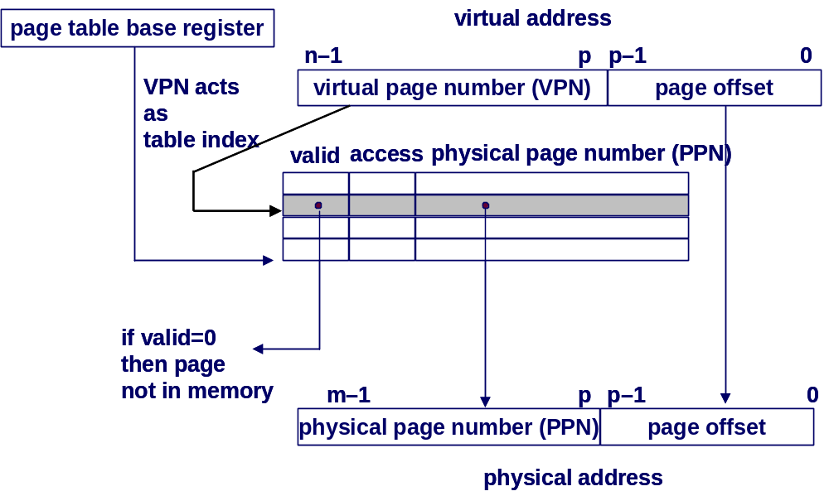
Page Table Operation
Translation
  Separate (set of) page table(s) per process
  VPN forms index into page table (points to a page table entry)

Slide 27
Page Table Operation
Computing Physical Address
  Page Table Entry (PTE) provides information about page
    if (valid bit = 1) then the page is in memory.
      Use physical page number (PPN) to construct address
    if (valid bit = 0) then the page is on disk
      Page fault

Slide 28
Page Table Operation
Checking Protection
  Access rights field indicate allowable access
    e.g., read-only, read-write, execute-only
    typically support multiple protection modes (e.g., kernel vs. user)
  Protection violation fault if user doesn’t have necessary permission

Slide 29
Integrating VM and Cache
VA
PA
miss
Trans-
lation
Cache
Main
Memory
CPU
hit
data
Most Caches “Physically Addressed”
  Accessed by physical addresses
  Allows multiple processes to have blocks in cache at same time
  Allows multiple processes to share pages
  Cache doesn’t need to be concerned with protection issues
    Access rights checked as part of address translation
Perform Address Translation Before Cache Lookup
  But this could involve a memory access itself (of the PTE)
  Of course, page table entries can also become cached

Slide 30
Speeding up Translation with a TLB
“Translation Lookaside Buffer” (TLB)
  Small hardware cache in MMU
  Maps virtual page numbers to physical page numbers
  Contains complete page table entries for small number of pages
hit
VA
PA
miss
TLB
Lookup
Cache
Main
Memory
CPU
miss
hit
Trans-
lation
data

Slide 31
Address Translation with a TLB
n–1
p
p–1
0
virtual page number
page offset
virtual address
valid
tag
physical page number
TLB
.
.
.
=
TLB hit
physical address
tag
index
byte offset
valid
tag
data
Cache
=
data
cache hit

Slide 32
Simple Memory System Example
Addressing
  14-bit virtual addresses
  12-bit physical address
  Page size = 64 bytes
13
12
11
10
9
8
7
6
5
4
3
2
1
0
VPN
VPO
(Virtual Page Number)
(Virtual Page Offset)
11
10
9
8
7
6
5
4
3
2
1
0
PPN
PPO
(Physical Page Number)
(Physical Page Offset)

Slide 33
Simple Memory System Page Table
  Only show first 16 entries
VPN | PPN | Valid | VPN | PPN | Valid
00 | 28 | 1 | 08 | 13 | 1
01 | – | 0 | 09 | 17 | 1
02 | 33 | 1 | 0A | 09 | 1
03 | 02 | 1 | 0B | – | 0
04 | – | 0 | 0C | – | 0
05 | 16 | 1 | 0D | 2D | 1
06 | – | 0 | 0E | 11 | 1
07 | – | 0 | 0F | 0D | 1

Slide 34
Simple Memory System TLB
TLB
  16 entries
  4-way associative
TLBT
TLBI
13
12
11
10
9
8
7
6
5
4
3
2
1
0
VPN
VPO
Set | Tag | PPN | Valid | Tag | PPN | Valid | Tag | PPN | Valid | Tag | PPN | Valid
0 | 03 | – | 0 | 09 | 0D | 1 | 00 | – | 0 | 07 | 02 | 1
1 | 03 | 2D | 1 | 02 | – | 0 | 04 | – | 0 | 0A | – | 0
2 | 02 | – | 0 | 08 | – | 0 | 06 | – | 0 | 03 | – | 0
3 | 07 | – | 0 | 03 | 0D | 1 | 0A | 34 | 1 | 02 | – | 0

Slide 35
Simple Memory System Cache
Cache
  16 lines
  4-byte line size
  Direct mapped
CT
CI
CO
11
10
9
8
7
6
5
4
3
2
1
0
PPN
PPO
Idx | Tag | Valid | B0 | B1 | B2 | B3 | Idx | Tag | Valid | B0 | B1 | B2 | B3
0 | 19 | 1 | 99 | 11 | 23 | 11 | 8 | 24 | 1 | 3A | 00 | 51 | 89
1 | 15 | 0 | – | – | – | – | 9 | 2D | 0 | – | – | – | –
2 | 1B | 1 | 00 | 02 | 04 | 08 | A | 2D | 1 | 93 | 15 | DA | 3B
3 | 36 | 0 | – | – | – | – | B | 0B | 0 | – | – | – | –
4 | 32 | 1 | 43 | 6D | 8F | 09 | C | 12 | 0 | – | – | – | –
5 | 0D | 1 | 36 | 72 | F0 | 1D | D | 16 | 1 | 04 | 96 | 34 | 15
6 | 31 | 0 | – | – | – | – | E | 13 | 1 | 83 | 77 | 1B | D3
7 | 16 | 1 | 11 | C2 | DF | 03 | F | 14 | 0 | – | – | – | –

Slide 36
Address Translation Example #1
Virtual Address 0x03D4
  VPN ___ TLBI ___ TLBT ____ TLB Hit? __ Page Fault? __ PPN: ____
Physical Address
  Offset ___ CI___ CT ____ Hit? __ Byte: ____
TLBT
TLBI
13
12
11
10
9
8
7
6
5
4
3
2
1
0
VPN
VPO
CT
CI
CO
11
10
9
8
7
6
5
4
3
2
1
0
PPN
PPO

Slide 37
Address Translation Example #2
Virtual Address 0x0B8F
  VPN ___ TLBI ___ TLBT ____ TLB Hit? __ Page Fault? __ PPN: ____
Physical Address
  Offset ___ CI___ CT ____ Hit? __ Byte: ____
TLBT
TLBI
13
12
11
10
9
8
7
6
5
4
3
2
1
0
VPN
VPO
CT
CI
CO
11
10
9
8
7
6
5
4
3
2
1
0
PPN
PPO

Slide 38
Address Translation Example #3
Virtual Address 0x0040
  VPN ___ TLBI ___ TLBT ____ TLB Hit? __ Page Fault? __ PPN: ____
Physical Address
  Offset ___ CI___ CT ____ Hit? __ Byte: ____
TLBT
TLBI
13
12
11
10
9
8
7
6
5
4
3
2
1
0
VPN
VPO
CT
CI
CO
11
10
9
8
7
6
5
4
3
2
1
0
PPN
PPO

Slide 39
Multi-Level Page Tables
Level 2
Tables
Given:
  4KB (2¹²) page size
  32-bit address space
  4-byte PTE
Problem:
  Would need a 4 MB page table!
    2²⁰ *4 bytes
Common solution
  multi-level page tables
  e.g., 2-level table (P6)
    Level 1 table: 1024 entries, each of which points to a Level 2 page table.
    Level 2 table: 1024 entries, each of which points to a page
Level 1
Table
...

Slide 40
Main Themes
Programmer’s View
  Large “flat” address space
    Can allocate large blocks of contiguous addresses
  Processor “owns” machine
    Has private address space
    Unaffected by behavior of other processes
System View
  User virtual address space created by mapping to set of pages
    Need not be contiguous
    Allocated dynamically
    Enforce protection during address translation
  OS manages many processes simultaneously
    Continually switching among processes
    Especially when one must wait for resource
      E.g., disk I/O to handle page fault

